Slide 1
MiNT-m: An Autonomous Mobile Wireless Experimentation Platform
Pradipta De et al. – Stony Brook University, Stony Brook, New York

Slide 2
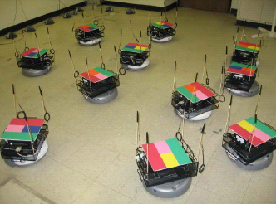
Devices - Nodes
Robotic vacuum cleaner called ‘Roomba’
  Controllable movements
  Effective auto-recharging capability
Wireless board: RouterBOARD
  4 mini-PCI 802.11 cards
  A radio signal attenuator

Slide 3
Devices - Servers
Control Server
  3 wireless network interfaces
  Control traffic on 11g channel, 11a channel for experiments.
Tracking server
  Cluster of PCs.
  Receive snapshots of the testbed captured by a 3x2 grid of web cameras

Slide 4
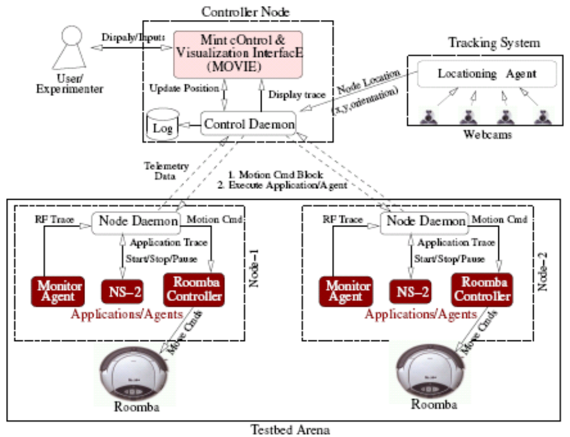
Software Architecture
Control daemon
Node daemon
Monitoring and managing interface – MOVIE (based on NAM, a visualization tool for ns-2)

Slide 5
Experiments on the Testbed
A user could specify:
  The testbed topology: click & drag
  The applications running on the nodes: ns-2 instance
  Mobility patterns of the nodes: specify the intermediate and final positions of the nodes
  Network interface card parameters: radio channel, RF power
Experiments through MOVIE
Testing data is displayed on MOVIE in real time.

